Slide 1


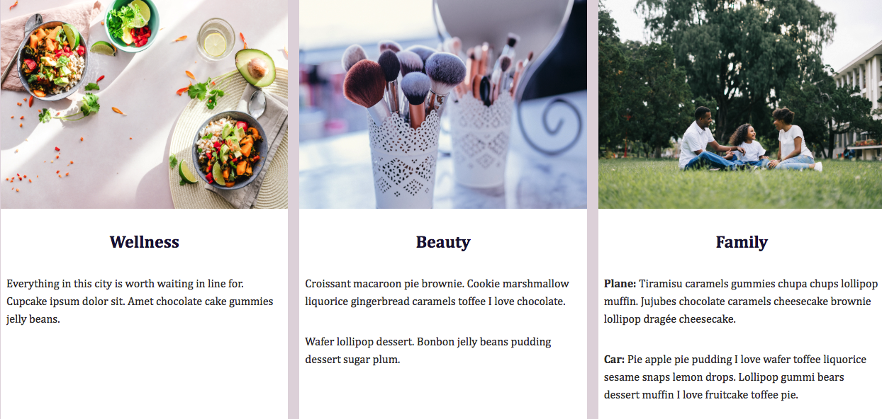

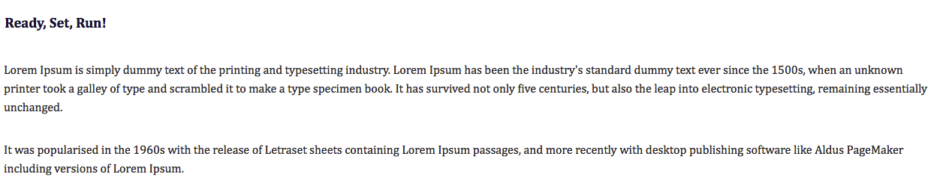

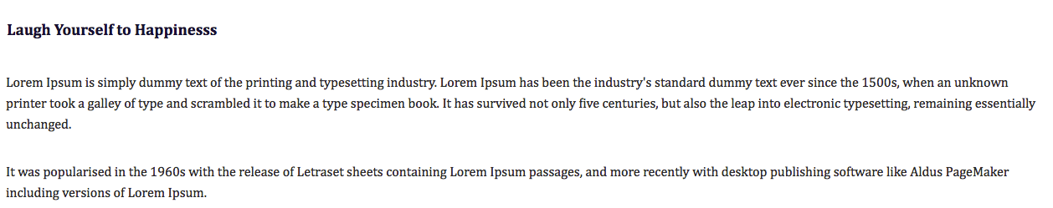

DESKTOP VERSION

Slide 2

TABLET VERSION

Slide 3


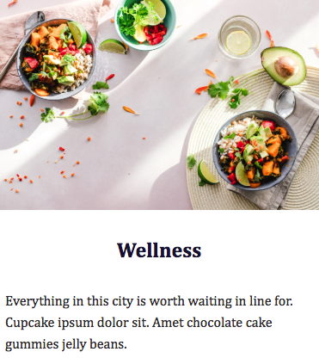
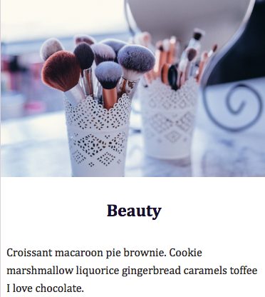
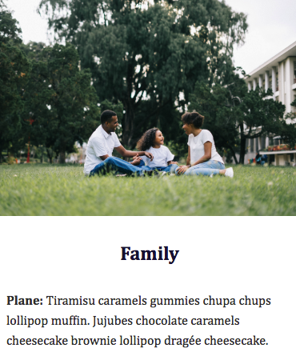
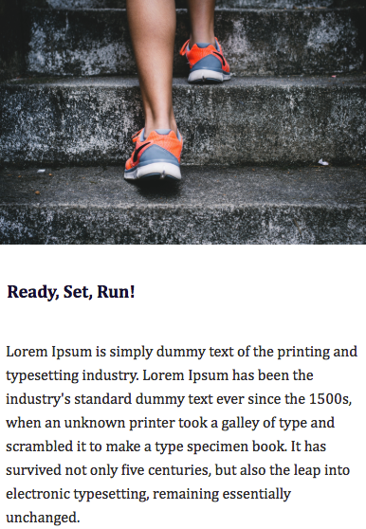
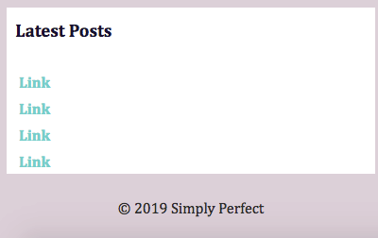
This will be
a clickable button.
MOBILE VERSION
The mobile version will fit the browser window, and this space will not be visible.
The mobile version will fit the browser window, and this space will not be visible.
The mobile version will fit the browser window, and this space will not be visible.
The mobile version will fit the browser window, and this space will not be visible.

